Slide 1
Catastic Case Study
Josh Knox

Slide 2
Table of Contents
Introduction
Overview
Problem Definition
Users & Audience
Roles & Responsibilities
Scope & Constraints
Process
Market Research & Competitive Analysis
User Research & Interviews
Ideation
Prototyping
Affinity & Usability Testing
Iteration
Outcomes
Results
Challenges
Lessons Learned
Opportunities

Slide 3
Introduction
Overview
Problem Definition
Users & Audience
Roles & Responsibilities
Scope & Constraints
Setting the stage

Slide 4
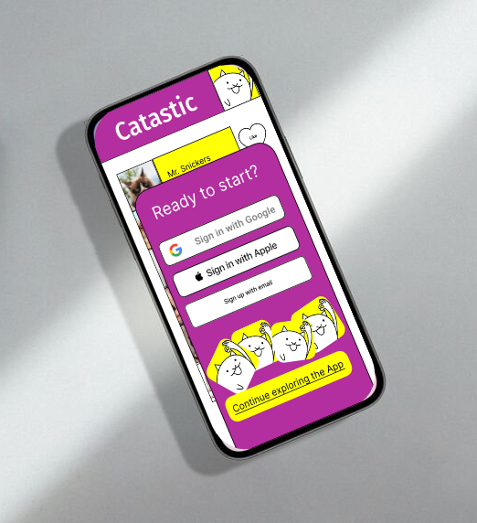
Overview
Catastic is a social media app looking to improve their sign up flow. After extensive user testing, I explored some areas of improvement:
Adding social login buttons
Offering an incentive
Allowing users to explore before signing up
Clear focus on cat pics

Slide 5
Problem Definition
Catastic wants a competitive sign-up flow for their up and coming mobile apps

Slide 6
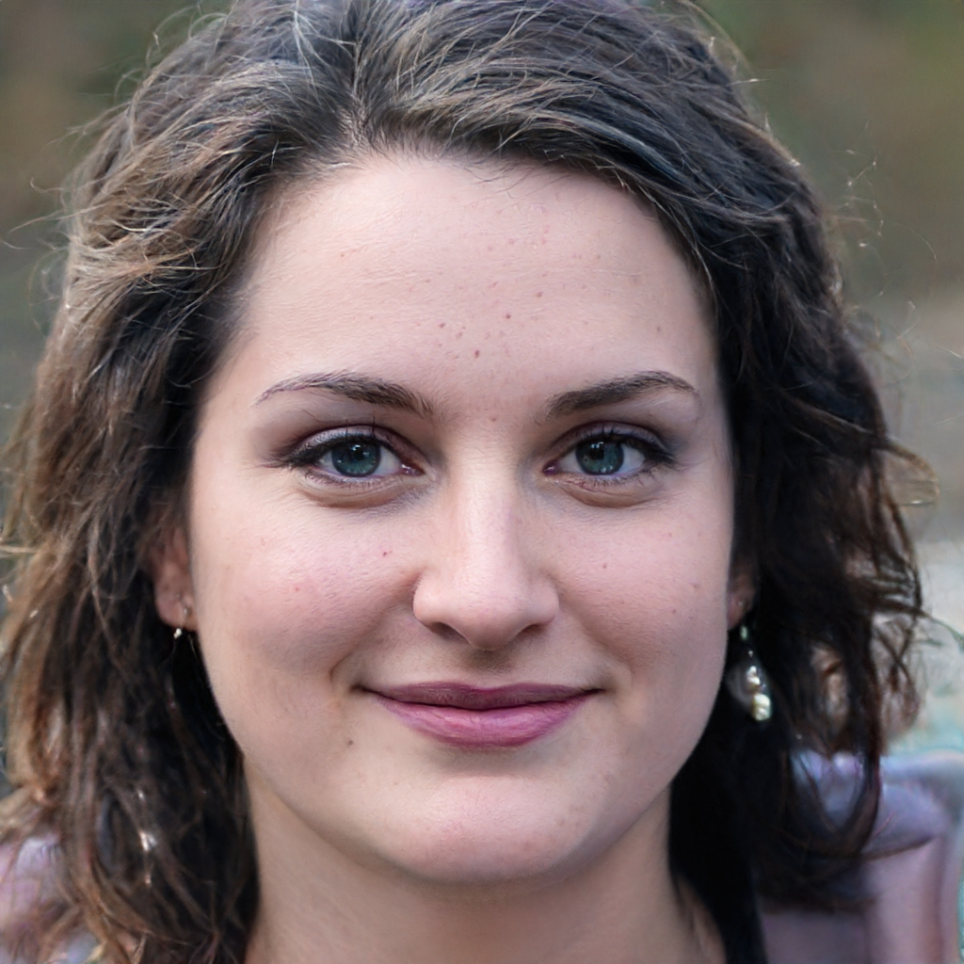
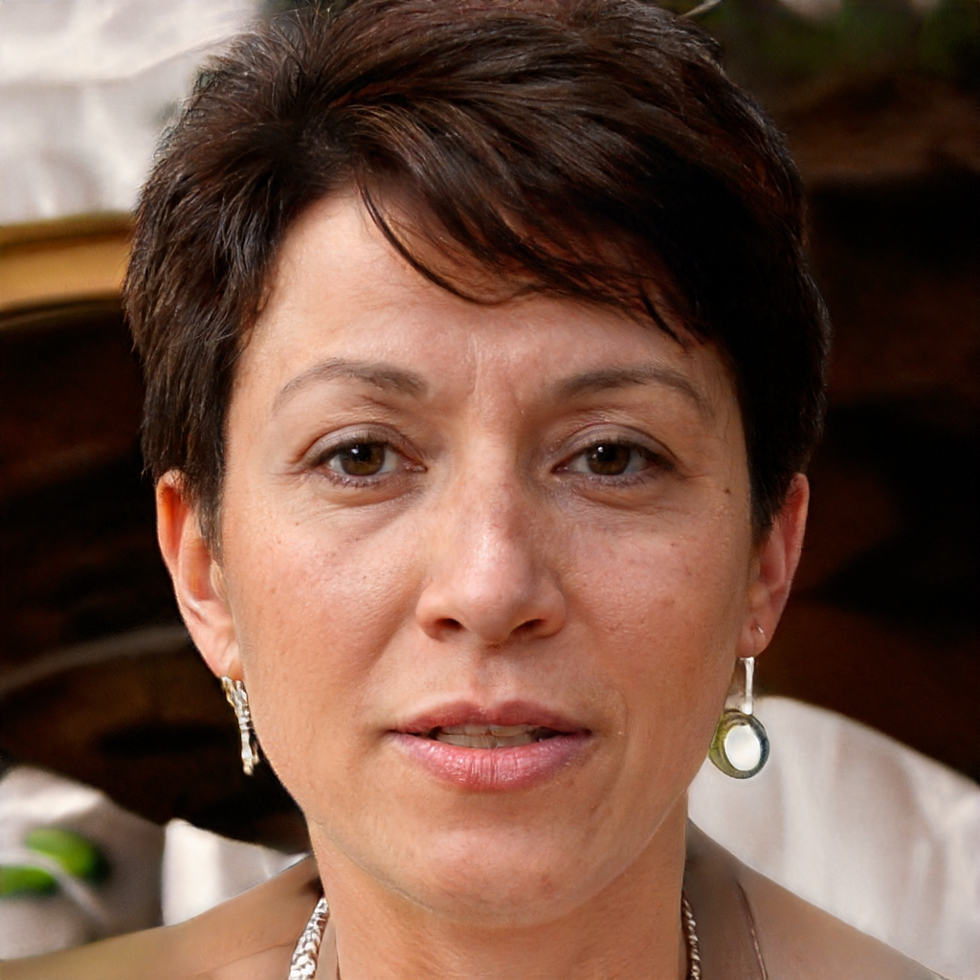


Users & Audience
The results broke down evenly across gender, and whether the user owned a cat.
The target age range is 35-49. Heavy social media users.
Samantha, 37
Not a cat owner, but loves looking at cat pics
Jasmine, 41
Cat owner and regularly posts pictures of her cats
Steven, 43
Not a cat owner but cat pics make him happy
Phil, 35
Cat owner and likes coupons and winning prizes
Notes:
I got this Presonas from the User surveys and the ones that said they would try this out and the age was 35-49.

Slide 7
Roles & Responsibilities
Initially when we broke out into roles I volunteered to sketch out ideas.
As we progressed, our team split out to to work on their own solutions.
We all provided feedback and support on surveys and ideas.

Slide 8
Scope & Constraints
Short timeline from concept to prototype
Had to be on a mobile phone
Speed to sign up is not the only factor – it also needs to be enticing to sign up

Slide 9
Process
Market Research & Competitive Analysis
User Research & Interviews
Ideation
Prototyping
Affinity & Usability Testing
Iteration
What happened, and why

Slide 10
Market Research & Competitive Analysis
Most social apps have social login (Sign In with Google, for example)
Facebook and Snapchat lock down many pages to make it difficult to use unless signed up
Pinterest, Reddit, Twitter, Instagram, TikTok allow you to explore before signing up

Slide 11
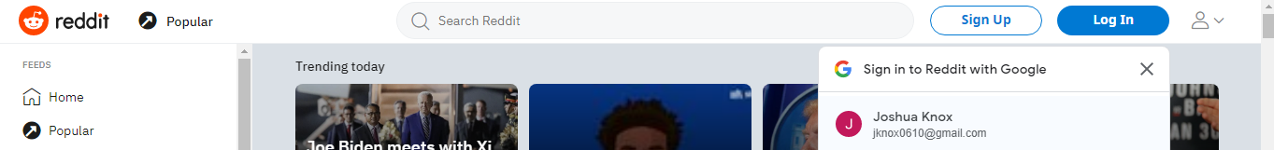
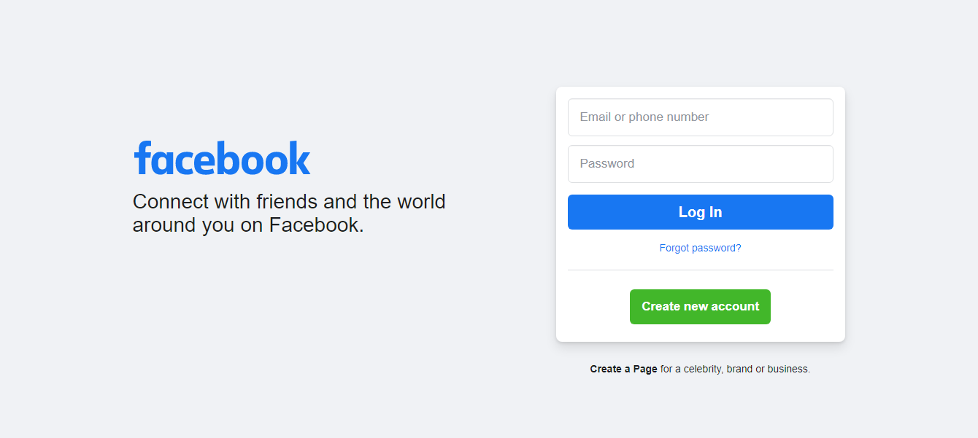
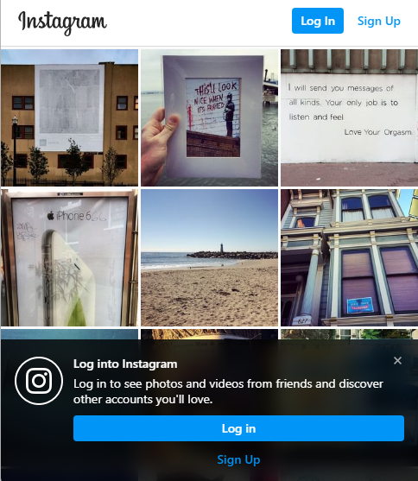

Slide 12
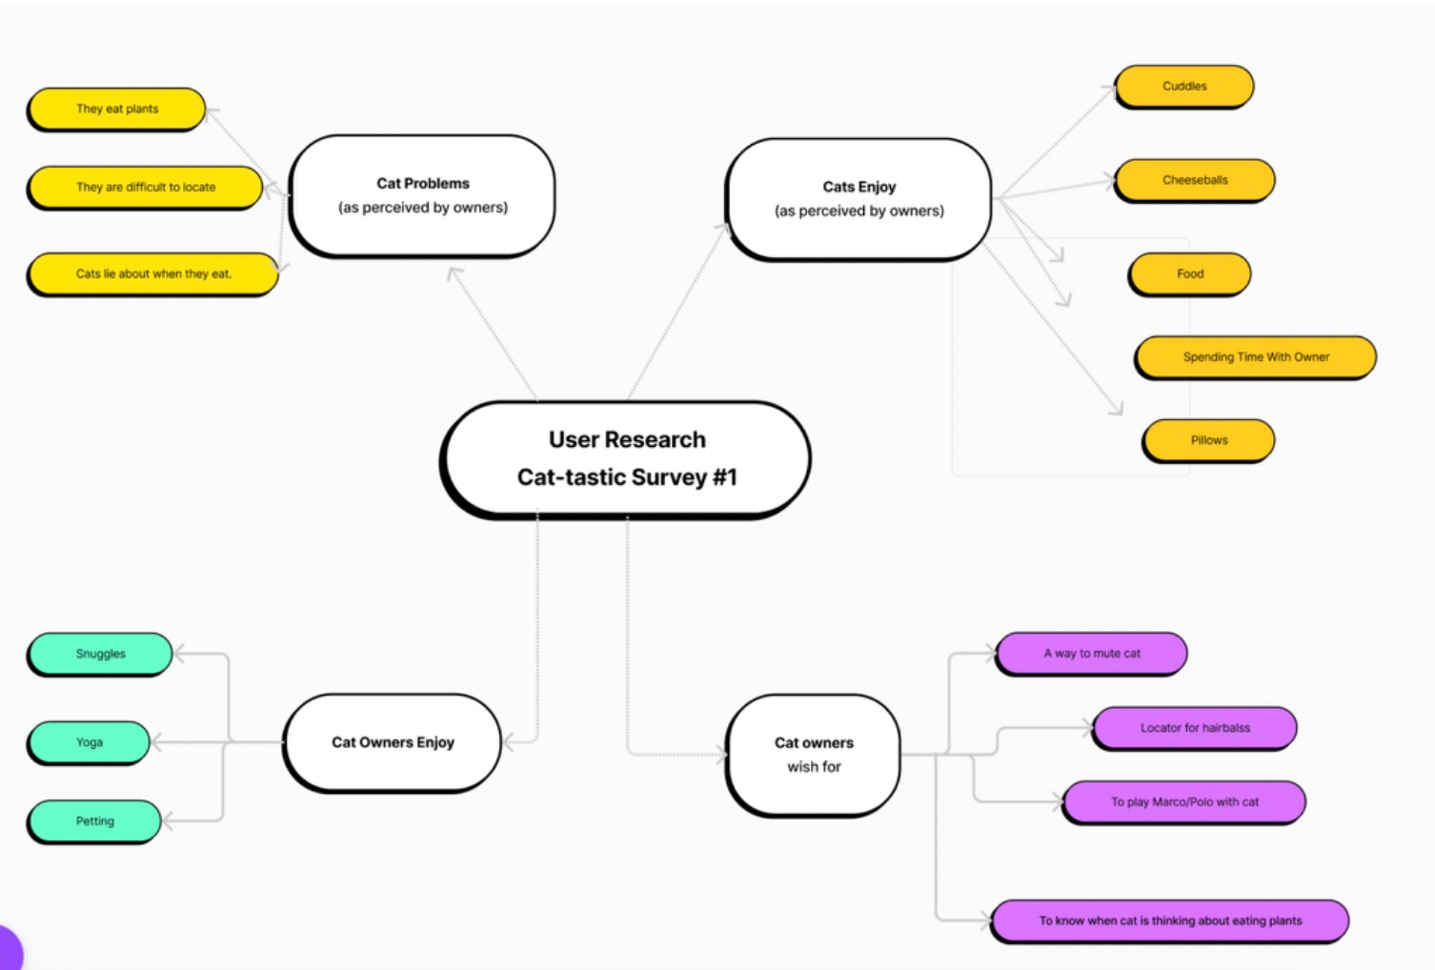
User Research & Interviews
Initially team was focused on cat ownership and problems with cats
I sent out surveys asking people about whether they would want to sign up for a new social media app (Mostly no.)
I interviewed my daughter about social media apps.
Notes:
My team did alot of reserach for this early stage of the product

Slide 13
Ideation
There were 3 major iterations of the idea
At first I started with a simple drawer with Sign In with Google
I received feedback to expand on it more, so I added an introduction
From there using the survey results I presented the incentive more prominently and made it clear what the app is for

Slide 14
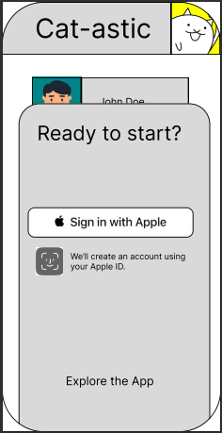
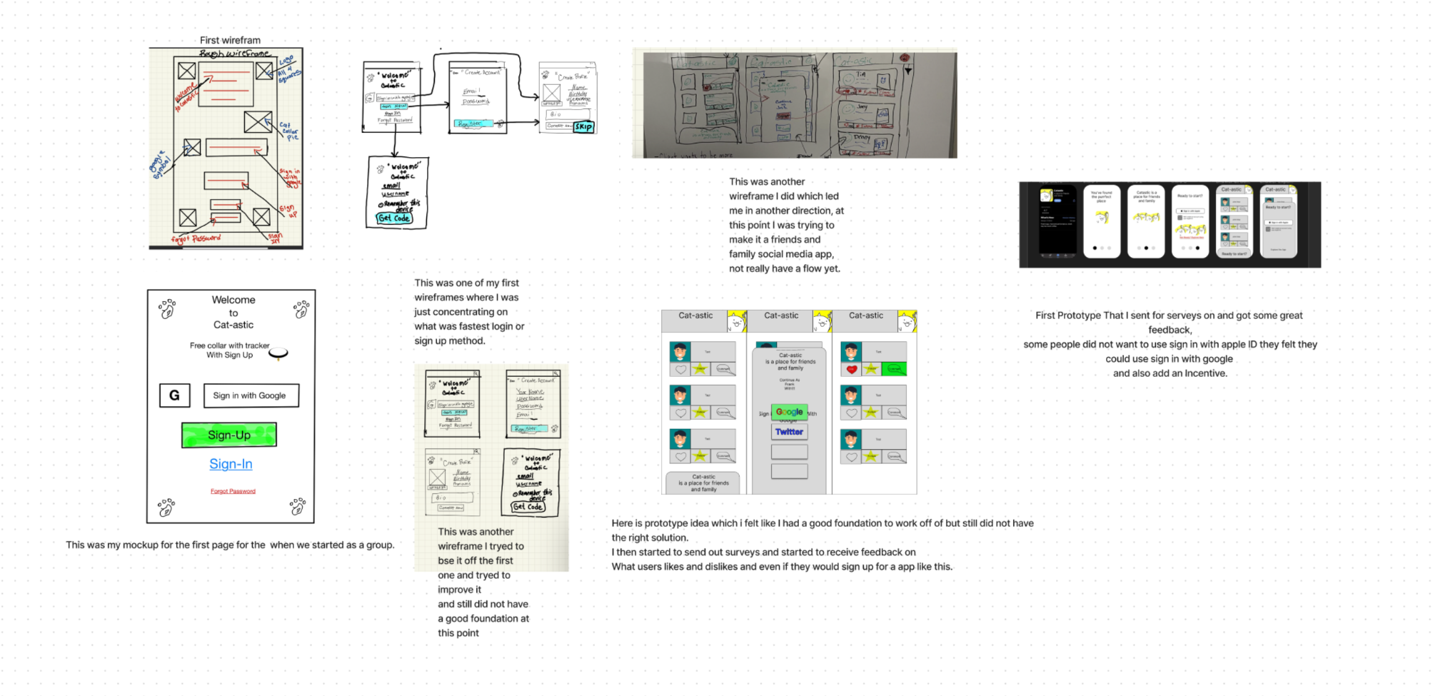
Wireframes/Prototypes
Notes:
The last prototype before I got my final feedback from users that took the surveys.

Slide 15
Prototyping
I sketched and whiteboarded ideas before moving to Figma
I created each screen as a frame in Figma
I connected each frame with transitions to make a Figma prototype
In the beginning I had a difficult time grasping how to use Figma but eventually I started catching on

Slide 16
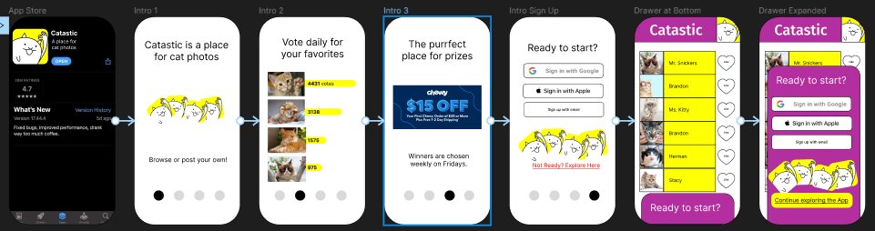
https://www.figma.com/file/5WaCCAM0Qhs42DqeZAFj9W/Final-Prototype?node-id=0%3A1
Notes:
https://www.figma.com/file/5WaCCAM0Qhs42DqeZAFj9W/Final-Prototype?node-id=0%3A1

Slide 17
Affinity & Usability Testing
I used Maze.co to send out my prototype to random users
I also watched as family members tried the prototype
"Neat app but I'm not looking to have more social apps."
"If I have the other major apps, why would I want this one?"
"If I ever get a cat again I would definitely use this app. It seems like a lot of fun and I love looking at animal pictures. "
Notes:
Users Survey Results

Slide 18
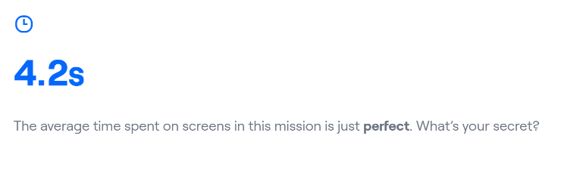
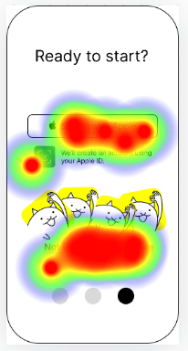
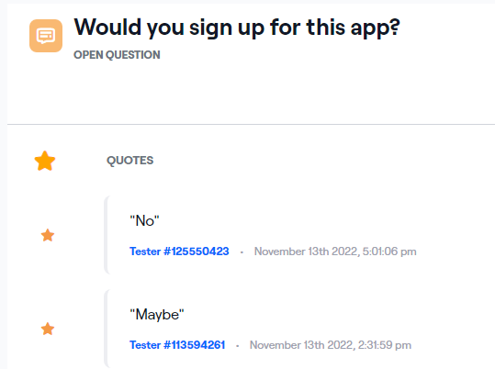
Notes:
Heat map how long each user spent on each slide.

Slide 19
Iteration
The feedback was extremely helpful and guided me to consider an incentive to sign up
The feedback didn't ask for an incentive but it became obvious when most people said they didn't have a need for more social apps
I sent out the wireframe again after making changes and got slightly better results

Slide 20
Notes:
feedback from users test. Added incentive coupon, and log in with google, log in with email.

Slide 21
Conclusion
Results
Challenges
Lessons Learned
Opportunities
Where things ended

Slide 22
Results
The incentive did not test as well as expected. One person said a higher value coupon might help.
In the first round of testing with my first prototype, 30% of people said they would sign up for the app. (70% said no.)
In the second round of testing with my final prototype, 40% of people said they would sign up for the app. (60% said no.)

Slide 23
Challenges
The hardest part was understanding how to use Figma to get my ideas out.
Finding people to test the app was also difficult. I did not have a large network of people I could use to do the testing. I looked online and used maze.co to create a survey about my prototype and send it out to random users for $5/each.

Slide 24
Lessons Learned
Always focus on what the user wants. I started out in one place and ended up somewhere completely different, because I kept iterating on feedback.
Teamwork: Helping each other as a group was useful but if we had split up into different roles and focused on one idea it might have been even better.

Slide 25
Opportunities
I think there are two options to explore:
Making it a cute and fun experience that's just about cat pictures
Making the incentive better (higher value coupon, for example)
If given the chance, I would integrate user testing earlier into the process, because once I had a cycle of getting feedback it was much easier to know what to do

Slide 26
Q&A

